Slide 1
Odoru A Real-Time Dance Companion Web App
En Wei, Weizhi Du, Zheyuan Wu

Slide 2
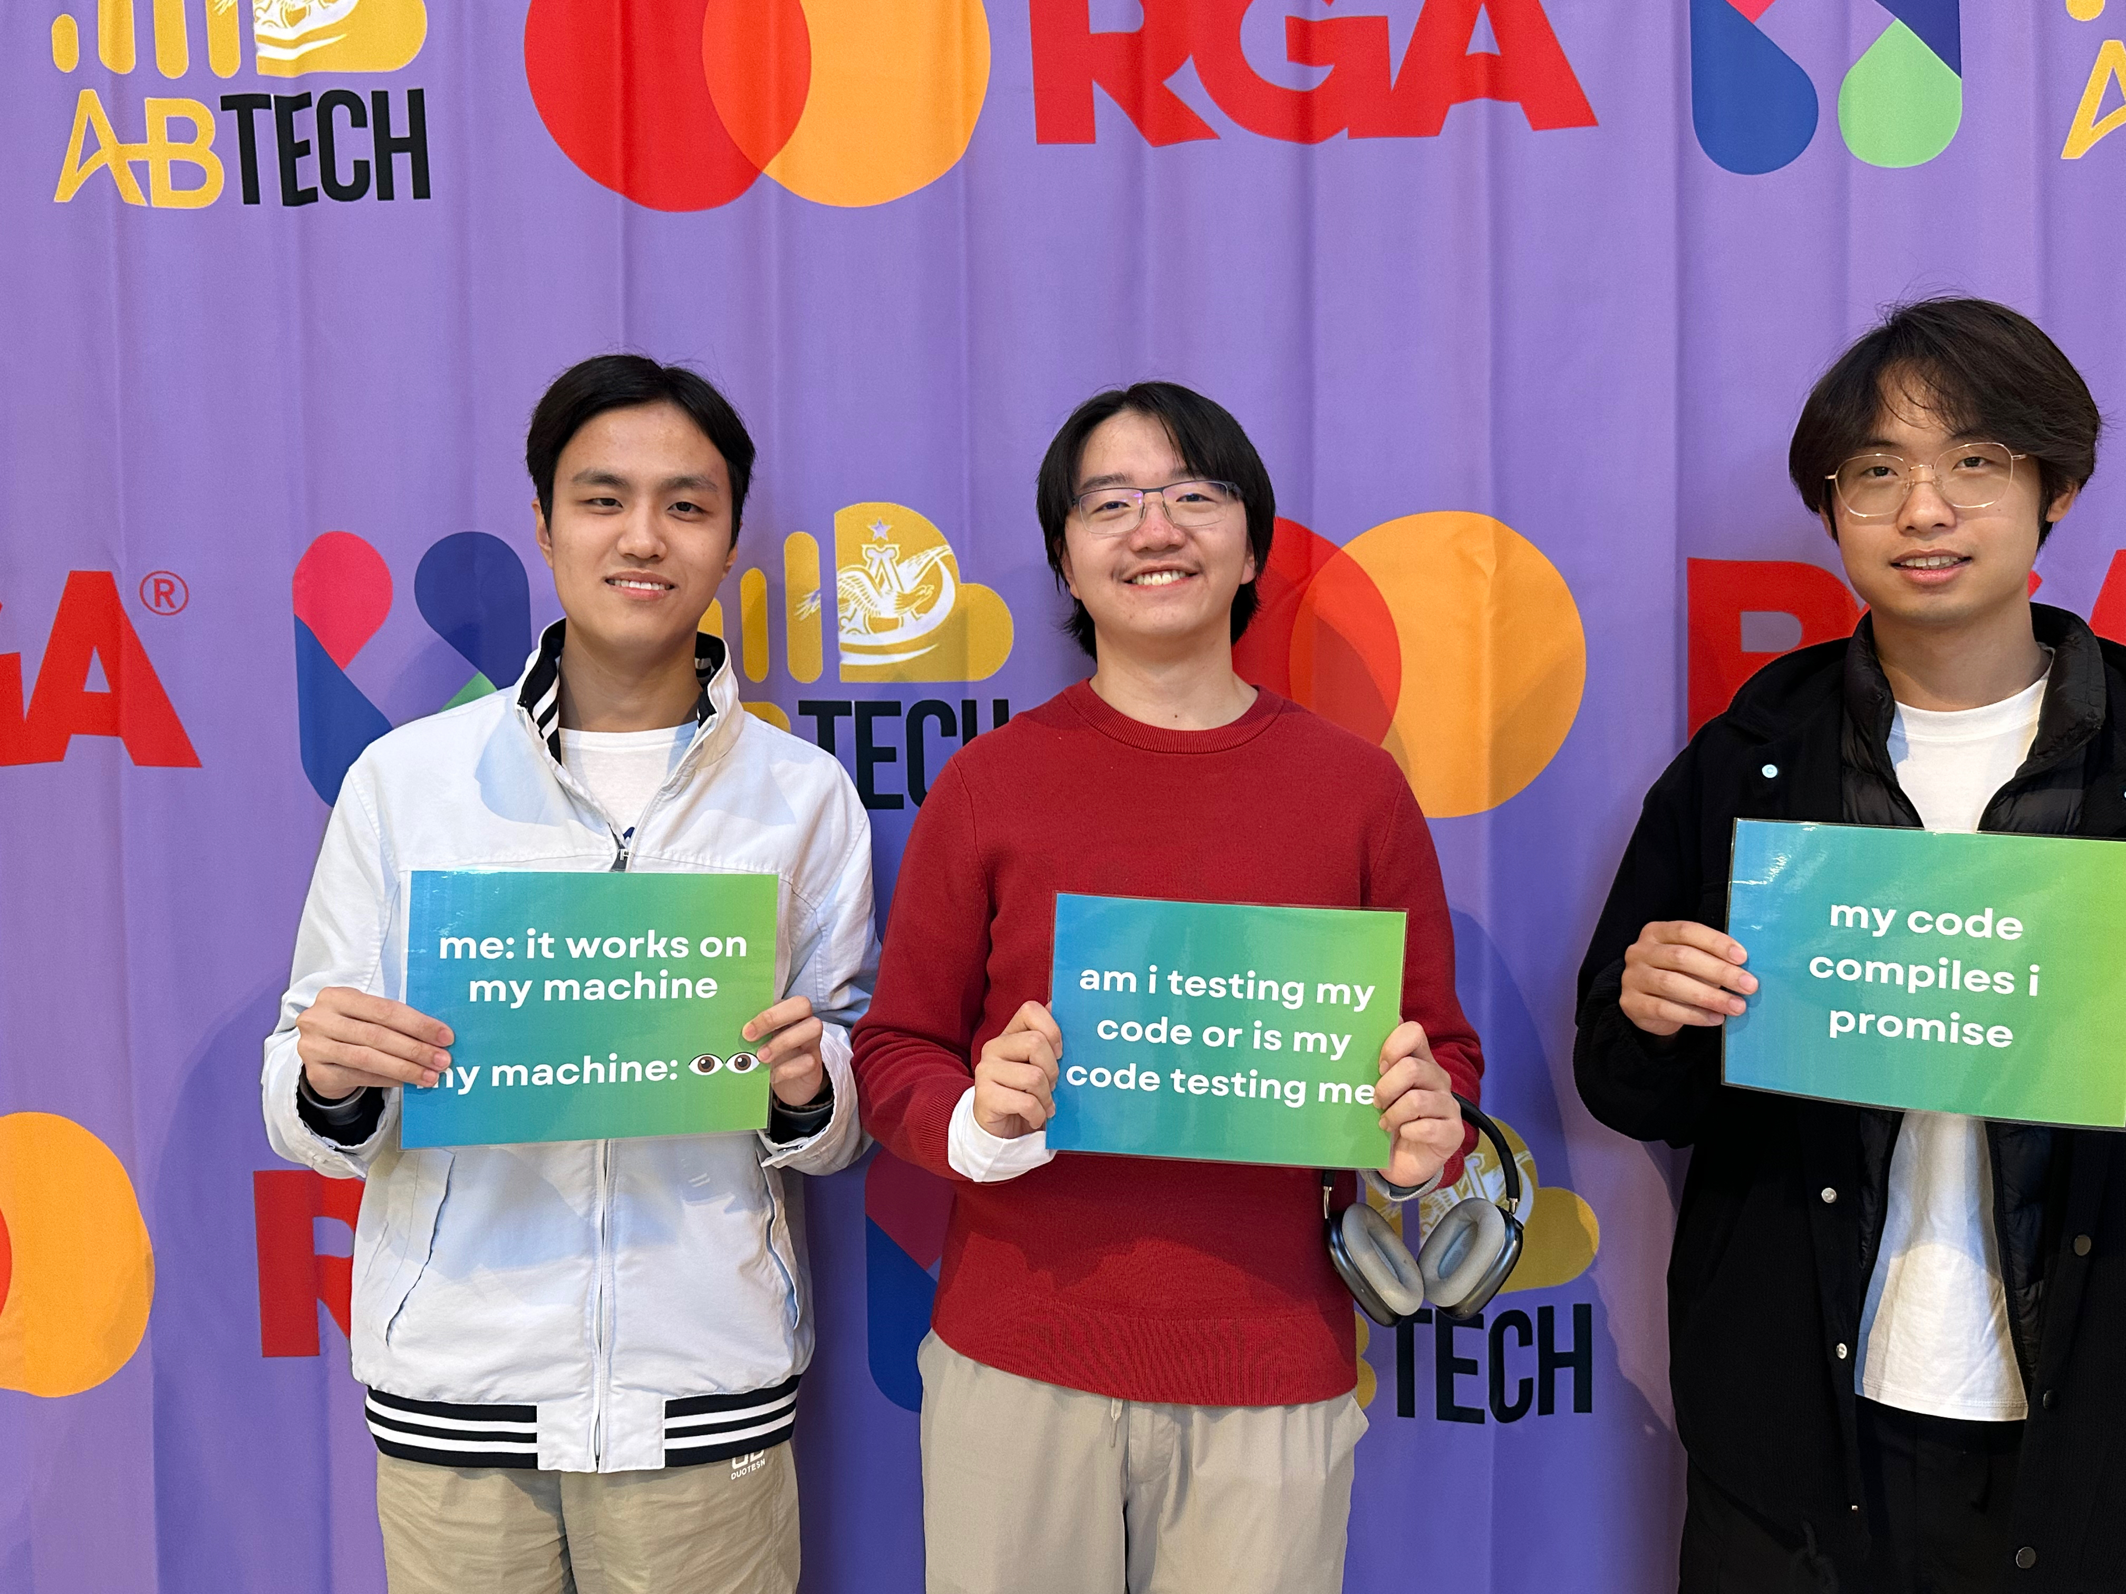
Team Members
Weizhi Du Sophomore
Majors: Computer Science & Financial Engineering Backend & Coordinator
Zheyuan Wu Junior
Majors: Math + Computer Science Frontend
En Wei First-year Majors: Computer Science
Computer Vision Engineering

Slide 3
Creativity
Odoru revolutionizes dance learning by enabling users to dance alongside a video while receiving feedback in real-time.
Combines entertainment with technology, promoting fitness and creativity.
Engages users by gamifying the dance experience with scoring and feedback.

Slide 4

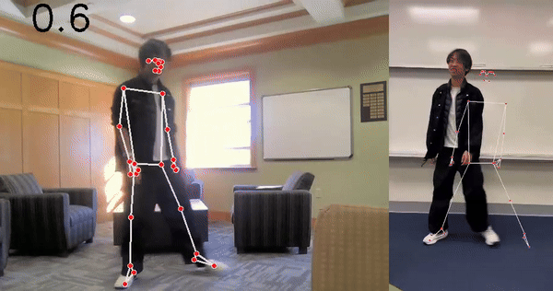
Product
Key Features:
Video Streaming: Users can select and dance along with a video.
Real-Time Pose Detection: Skeleton detection to track movements using advanced computer vision techniques.
Responsive UI: Smooth user interaction throughout the dance session.

Slide 5






Technical Prowess
Integrated multiple technologies: Frontend, Backend, Computer Vision.
Utilized OpenCV and MediaPipe for pose detection, requiring understanding of machine learning models.
Implemented real-time communication with Flask-SocketIO for seamless feedback communication.
Addressed challenges in achieving low latency in pose recognition and scoring updates.

Slide 6
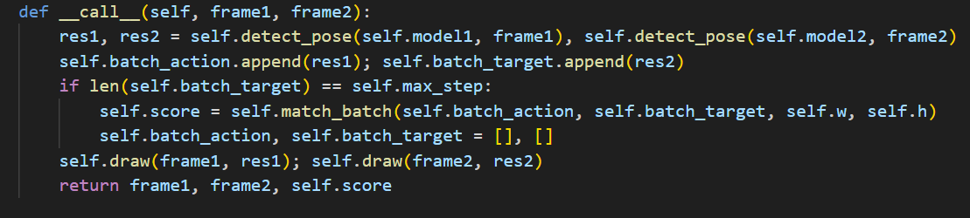
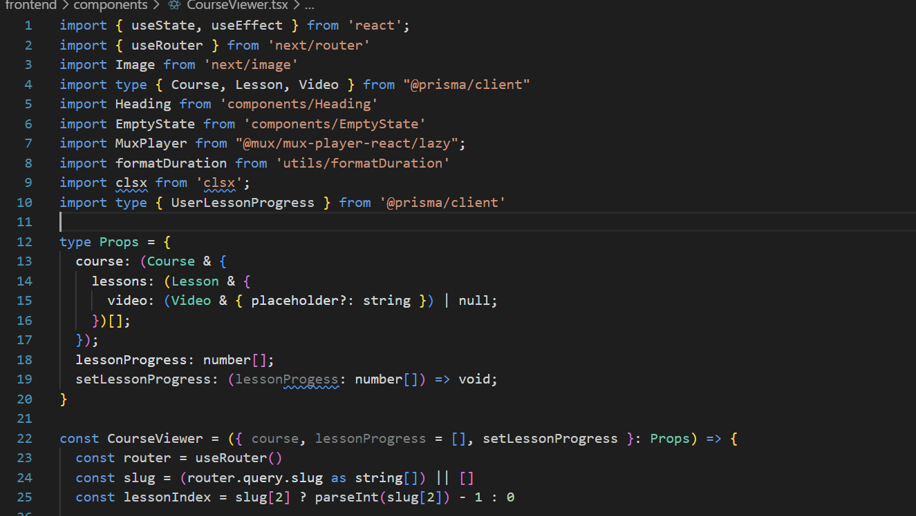
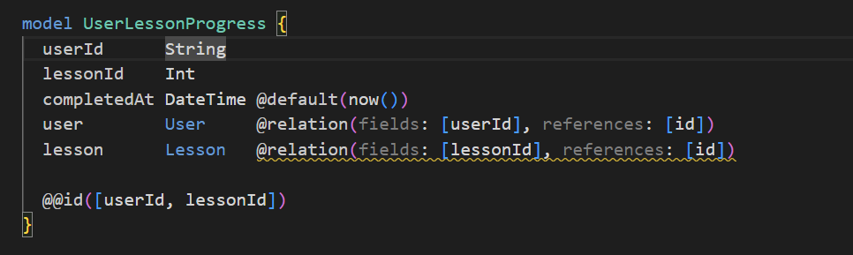
Implementation
Complete functionality from video selection to real-time scoring during dance.
Responsive interface built with Tailwinds CSS, Next.JS, React.
Backend powered by Flask, handling video processing and scoring logic.

Slide 7
Live Demo

Slide 8
Thanks for Viewing

